Slide 1


Subject Name : WIRELESS COMMUNICATION Presentation Title : CDMA TECHNOLOGY TO WIRELESS LOCAL LOOP SERVICE
JEPPIAAR INSTITUTE OF TECHNOLOGY
“Self-Belief | Self Discipline | Self Respect”
Department of Electronics and Communication Engineering
Team Members:
Students Name Reg.No:
1. Vetrivel. l 210617106084
2.Vignesh.P 210617106088
3 .Vignesh.M 210617106087
4. Shachinkguru.S 210617106073
5. Supraja.T 210617106077
6. Vidyalakshmi.M 210617106086

Slide 2
SYNOPSIS:
Abstract
What is CDMA technology ?
Synchronous and Asynchronous
Working of CDMA
WLL
Types of spread spectrum
Universal frequency reuse and CDMA capacity
Advantages of CDMA
Conclusion

Slide 3
ABSTRACT
CDMA technology is used in Wireless Local Loop (WLL) applications to satisfy demands quickly and efficiently.
Wireless telephony has focused primarily on mobile applications until recently.
The huge demand for telephone service, which has emerged in many parts of the world, coupled with the long lead times to install outside plant, has led to the application of wireless technology with fixed location wireless subscriber equipment.
CDMA technology has proven to have a significant advantage over other wireless technologies, because of its large capacity and its superior economics.

Slide 4
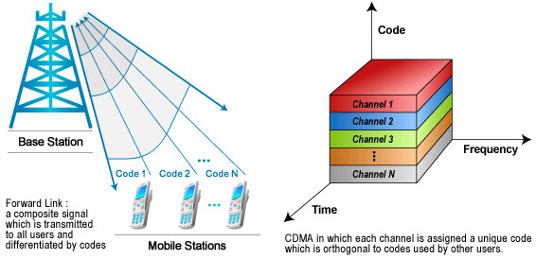
What is CDMA technology?
CDMA technology is used in commercial cellular communications to make better use of radio spectrum when compare to other technologies. This technology was used as a military technology for first time in the World War II by the English associates to break the German attempts of jamming transmissions.
CDMA technology is known as a spread-spectrum technique which allows many users to occupy the same time and frequency allocations in a given band and space. Individual conversations are encoded with the help of pseudo-random digital sequence.

Slide 5
SYNCHRONOUS:
Synchronous CDMA is defined as exploiting the mathematical properties orthogonally between vectors representing the data strings. This digital modulation method is analogous to the one used in simple radio transceivers.
ASYNCHRONOUS
This CDMA system offers a key advantage in the flexible allocation of resources. Asynchronous CDMA is best suited to a mobile network wherein large numbers of transmitters produce relatively small amount of traffic at irregular intervals.

Slide 6
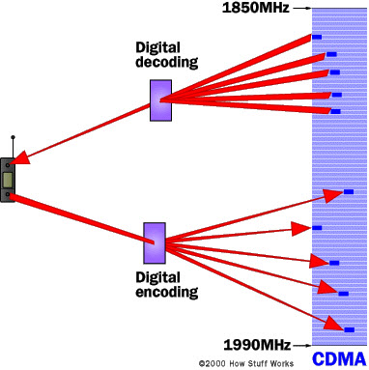
Working of CDMA technology?
Code division Multiple Access is entirely a different approach from the Time Division Multiple Access. CDMA, after digitizing the data, spreads out the date over the entire available bandwidth. Multiple calls are overlapped to each other on a channel which is assigned with a unique sequence code. CDMA is a form of spread-spectrum technique, which means data can be sent in small pieces over a number of frequencies available to use at any time in the specified range.
CDMA WorkingAll the users’ data can be transmitted in a similar way to that of wide band chunk of spectrum. Users Signals are spread over the entire bandwidth by a unique spreading code. At the receiver end, the same code is used to recover the signal. CDMA system requires accurate time stamp on each piece of a signal. Eight and ten separate calls are carried out in the same channel space as one analog call.

Slide 7
WLL(WIRELESS LOCAL LOOP)
For fixed applications, three different kinds of WLL subscriber equipment can be identified.
The simplest looks like a standard wireline home or office telephone with an antenna attached.
For business application, a system is required which can accommodate voice, data, and fax.

Slide 8
Types of spread spectrum communinication:
Frequency Hopping
Direct Sequence
Frequency Hopping
Frequency hopping is the easiest of all the spread spectrum modulation technique to use. The idea behind frequency hopping is to transmit data across a broad spectrum; the frequency can be rapidly switched from one to another. The transmitter and receiver are synchronized every time, and an accurate clocking system, and pseudo generating system make this frequency hopping very simple
Direct Sequence
Direct sequence is the most famous spread spectrum technique in which the data signal is multiplied by a Pseudo-random noise code. A PN code is a sequence of chips which is given values as -1 and 1 (non polar) or 0 and 1 (polar). The number of chips within one code is known as the period of this code. The digital data is directly coded at higher frequency, and the code is generated pseudo randomly. A receiver knows how to generate the same code and correlates the received signal with that code to extract the data.

Slide 9
Universal Frequency Reuse and CDMA Capacity
One of the most significant advantages of CDMA, for WLL, cellular and PCS applications is in the area of frequency reuse.
Narrowband systems (AMPS, D-AMPS, GSM) cannot reuse frequencies in adjacent service areas because of sensitivity to interference.
Frequency reuse planning to meet requirements for the signal to interference ratio severely limits spectral efficiency.
Typical frequency reuse for narrowband systems is 7 (or 21, for 3 sector cells)

Slide 10
Advantages of CDMA:
Improvement in capacity and security:
One of the chief claims of CDMA is that it gives significant improvements in network capacity. In CDMA technology data and voice packets are separated using codes, and then transmitted by using a wide range of frequencies. Because more space is allocated for data in CDMA, this standard has become attractive for 3G high-speed mobile internet use.
Improvement in hand over/ hand off:
By using CDMA technology, it is easy for a terminal to communicate with two base stations at once. In case of this, old link is to be broken when the new one is firmly established. This provides improvement in terms of the reliability of hand over/hand off from one base station to another.
CDMA technology has been used in 3G telecommunication systems in one form or the other. CDMA has become successful in every aspect, and it has enabled improvements need to be gained over the previous technologies used in 2G systems.

Slide 11
Conclusion:
CDMA has many technological advantages, including lower power, higher capacity, better frequency reuse, and better link budget.
CDMA's multipath advantage and soft hand-off are important for mixed WLL cellular systems.
And CDMA is inherently more private than other wireless technologies.
These technological advantages translate into strong economic advantages.
CDMA WLL provides outstanding reliability, rapid deployment, flexibility, and it is less expensive to deploy, operate and upgrade.

Slide 12
REFERENCE
QUALCOMM Inc. (white paper available from) "Economics of Wireless Local Loop“
https://link.springer.com/chapter/10.1007/978-0-387-34985-5_25

